Slide 1


A new era begins…

Slide 2

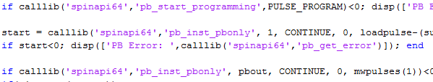
Why?
Need to free ourselves from the rule of bad very task specific coding
Code must handle increasingly complex experiments

Slide 3
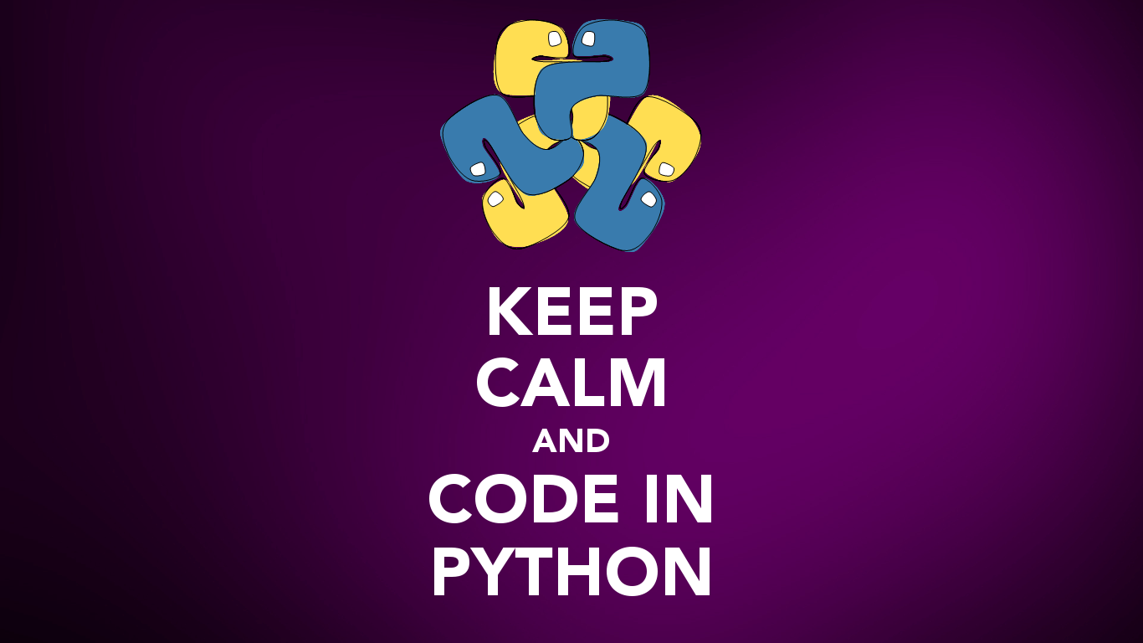

Slide 4


Main features
High-level, interpreted programming language
Object-oriented programming
Import packages for specific functionality
Indentation has meaning
No semicolons needed
https://docs.python.org/3.5/tutorial/

Slide 5
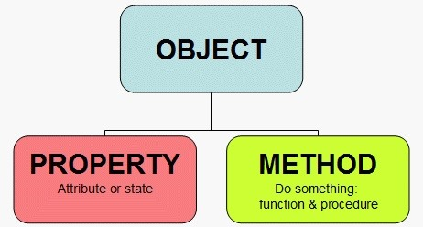
Object oriented programming
Building blocks

Slide 6
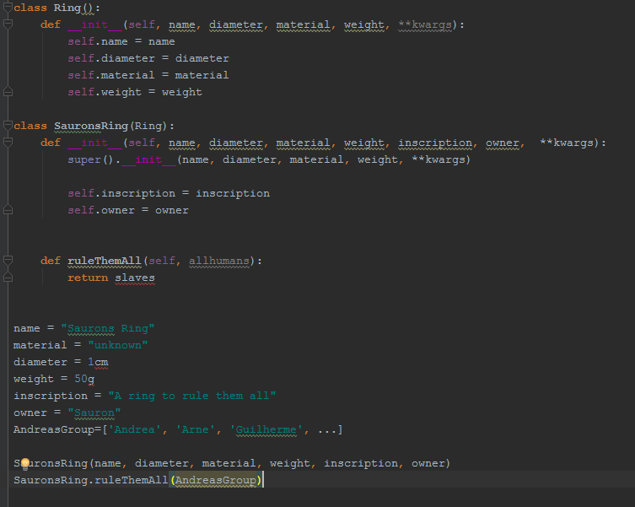


SuperClass
Class
Properties
Initialization
Properties
Method
Instance

Slide 7





QCoDeS
StationQ
Sydney
Copenhagen
Delft
Microsoft
Spearheaded by
Initial: Alex Johnson
Current: Giulio Ungaretti

Slide 8
QCoDeS
QCoDeS is a Python measurement software package
Covers aspects common to all measurements
Instrument communication
Performing measurement
Data management
Plotting
Active community with frequent updates

Slide 9
Typical measurement flow
1. Initialize
Connect to instrument
Setup instruments
Create data array
2. Measure
Loop over parameter(s)
Acquire signal (and analyse)
Add data to array
Plot results
3. Finalize
Store data
Close instrument communication
Plot results

Slide 10
Typical measurement flow
1. Initialize
Multiprocessing
Separate server (process) for each set of tasks
Handles different tasks in parallel.
Main server remains free!
Connect to instrument
Setup instruments
Create data array
2. Measure
Loop over parameter(s)
Main server
Acquire signal (and analyse)
Add data to array
Measurement server
Plot results
3. Finalize
Instrument server(s)
Data server
Store data
Close instrument communication
Plotting server

Slide 11
SilQ
SilQ is our experiment python package that utilizes QCoDeS
QCoDeS contains everything common to all groups
SilQ contains everything specific to our group

Slide 12
SilQ
What goes where
Custom parameters
Instrument drivers
Notebooks
Experiment/personal scripts
Analysis
Advanced plotting

Slide 13



The interpreters

Slide 14
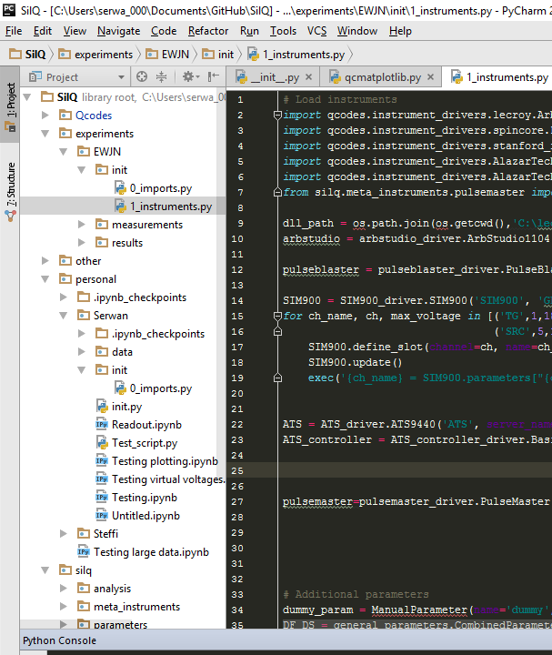
PyCharm
Similar IDE to Matlab
High-performance, with lots of useful functionality
Has debugging mode
Contains list of workspace variables
Script-based programming
To run a script in PyCharm, it should start with:
if __name__ == "__main__": *Programming code*…

Slide 15

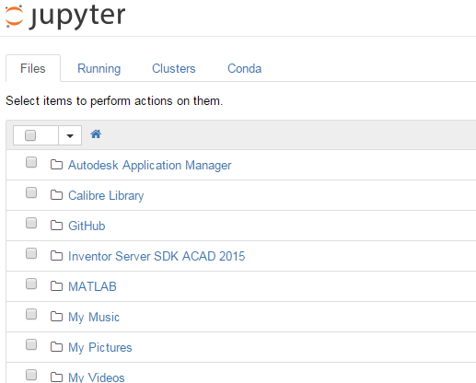
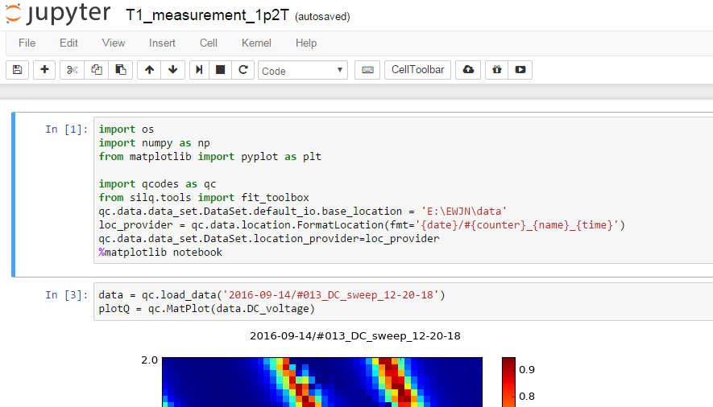
Notebook
Interactive programming
Operates in webbrowser
Uses notebooks
Code is run in cells
Variables remain in workspace

Slide 16
Jupyter notebook example: Real time measurement
Hosted on server accessible with vpn connection from everywhere
Jupyter notebook in Berdina measurement computer
http://129.94.115.27:8889/

Slide 17

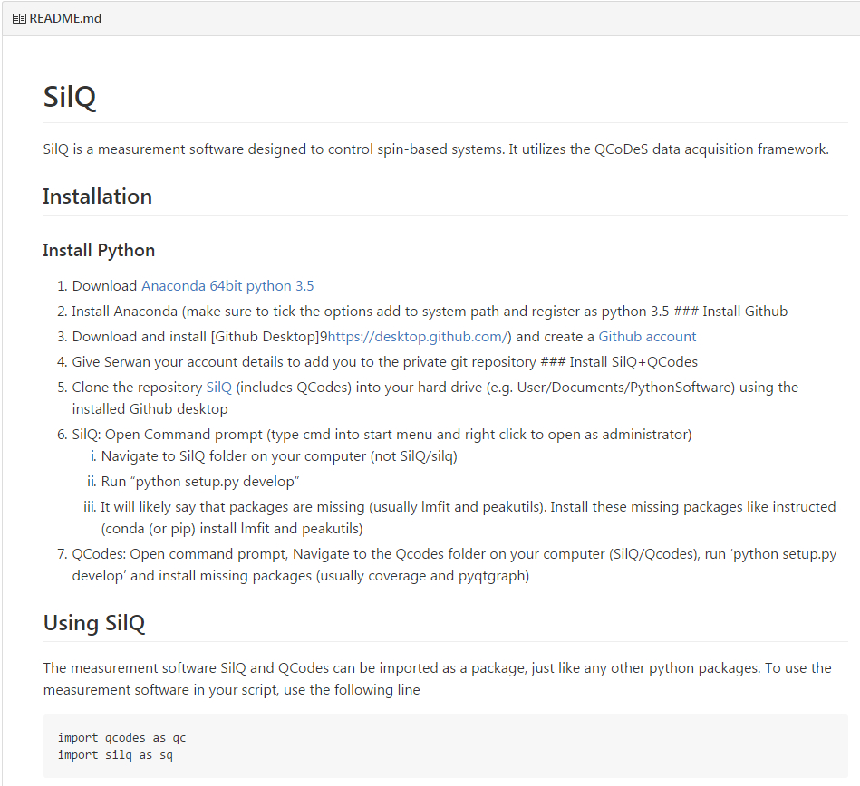
Installation
Description on the github page
https://github.com/nulinspiratie/SilQ

Slide 18


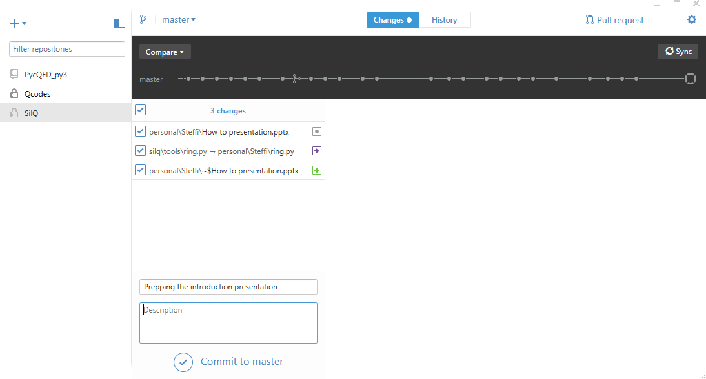
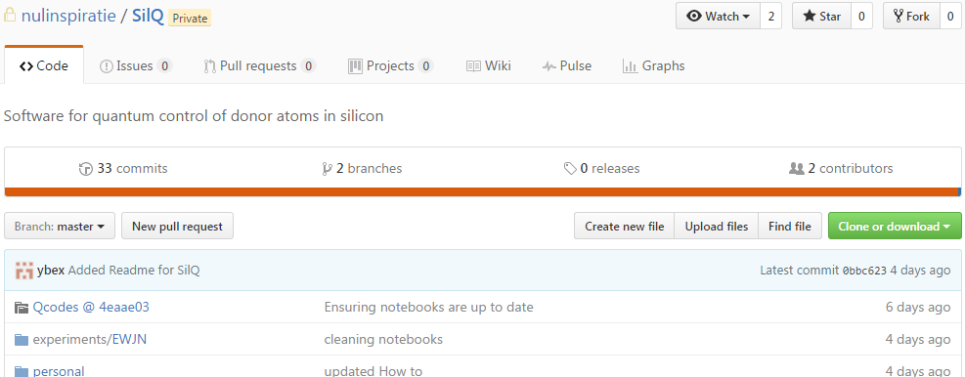
github
Github online

Slide 19
How to code well

Slide 20



Coding rules
Python
https://www.python.org/dev/peps/pep-0008/#prescriptive-naming-conventions
Should adhere to common coding style:
Use 4 spaces per indentation level (use tabs)
Imports on top of the file
Class names should normally use the CapWords convention
Function names should be lowercase, with words separated by underscores
Always use self for the first argument to instance methods
Underscores for variables:
__foo__: convention, a way for Python to use names that won't conflict with user names.
_foo: convention, a way for the programmer to indicate that the variable is private (E.g. from M import * does not import objects whose name starts with an underscore)
__foo: this has real meaning: the interpreter replaces this name with _classname__foo as a way to ensure that the name will not overlap with a similar name in another class.
foo = long_function_name(var_one, var_two,
var_three, var_four)
Us: Do NOT use abbreviations and DO write descriptive comments

Slide 21
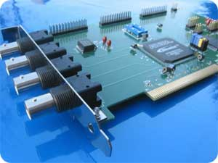
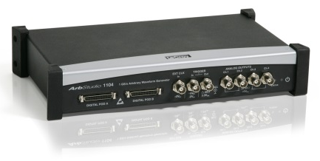
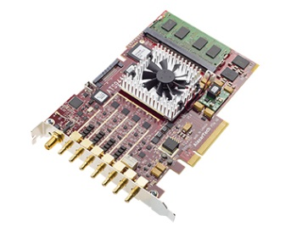
Varying setup
Pulseblaster
An experimental setup often changes
Can become a
Arbstudio
coding nightmare
Berdina
Digitizer

Slide 22
Pulseblaster
Varying setup
An experimental setup often changes
Can become a
Arbstudio
coding nightmare
coding nightmare
Berdina
Digitizer

Slide 23
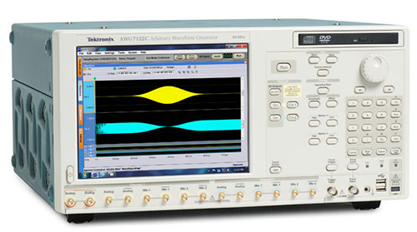

Varying setup
Pulseblaster
An experimental setup often changes
Can become a
Tektronix AWG
coding nightmare
Berdina
Digitizer

Slide 24
Proposed solution: PulseMaster
The PulseMaster is a meta-instrument that knows the instruments in the setup and their connectivity
Input is high level operations, such as
SinePulse(frequency=2.5*GHz, duration=10*ms)
Determines the available instrument for pulse
Controls the instruments and ensures triggering
Requires an interface for each instrument

Slide 25
Typical measurement
No direct access between high-level operations and instruments
Allows same code to be reused for different setups
Measurement
parameter
PulseMaster
Pulseblaster
Arbstudio
Digitizer

Slide 26

The journey is not over yet…
Help needed!!!
PulseMaster
Steering
Adding instrument drivers
ESR/NMR drive
GUIs
In–situ change of measurement loops
Continuous QCoDes updates
And many more…

